Slide 1
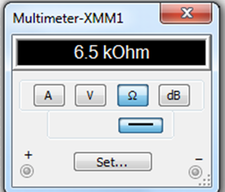
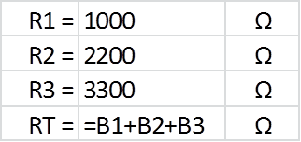
Resistors in Series
Formula:
RT = R1 + R2 + R3…
Verified in MultiSim:

Slide 2
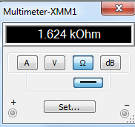
Resistors in Parallel
Formula:
Verified in MultiSim

Slide 3


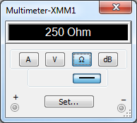
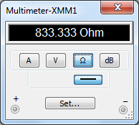
Resistors in Parallel
(continued)
Formula for Multiple Equal Resistors:
Formula for two Unequal Resistors:
Verified by MultiSim

Slide 4
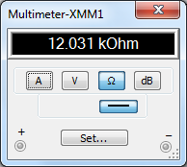
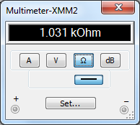

Resistors in Series/Parallel
Formula:
First, use parallel formula,
then use series formula.
Verified in MultiSim

Slide 5
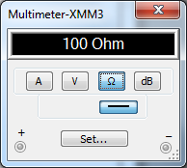
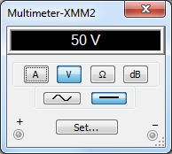

Thevenin
Verified in MultiSim
RT
V_{TH}
Formulas for I_{L} and V_{L}:
R_{TH}

Slide 6
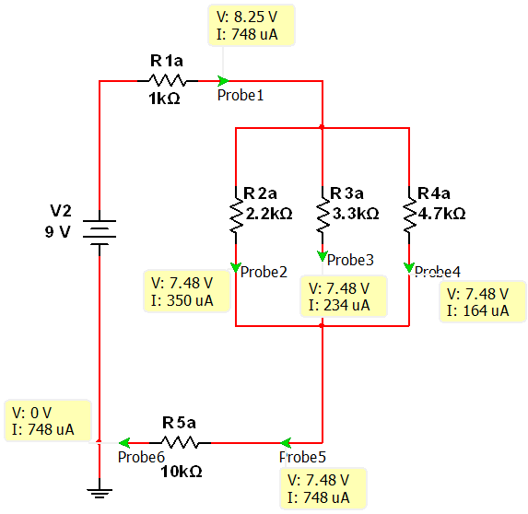
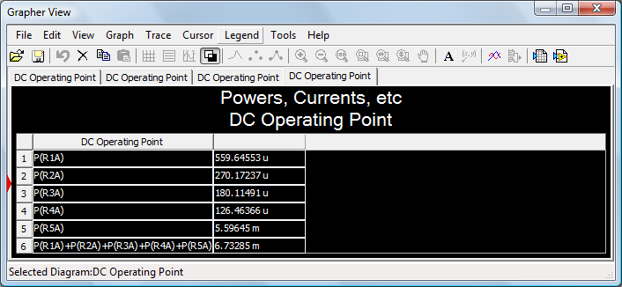
Powers and Currents
VB
VC

Slide 7
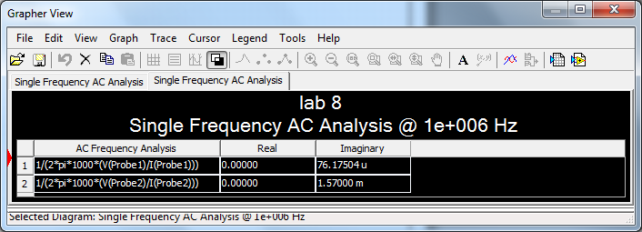
Capacitors
In Parallel
In Series
Verified in MultiSim

Slide 8
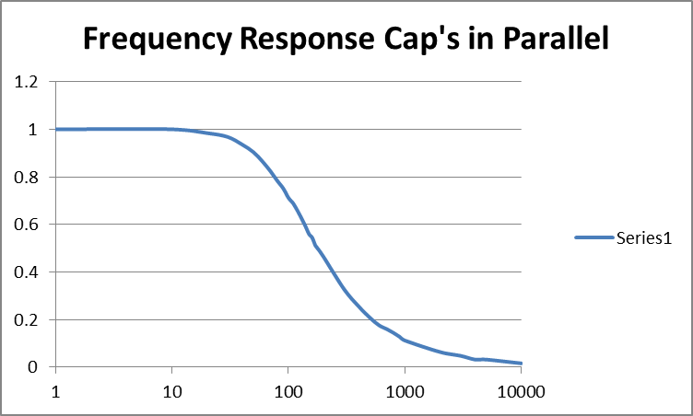
Xc as a Function of Frequency
Parallel Capacitors:
As frequency increases, Capacitance decreases.

Slide 9
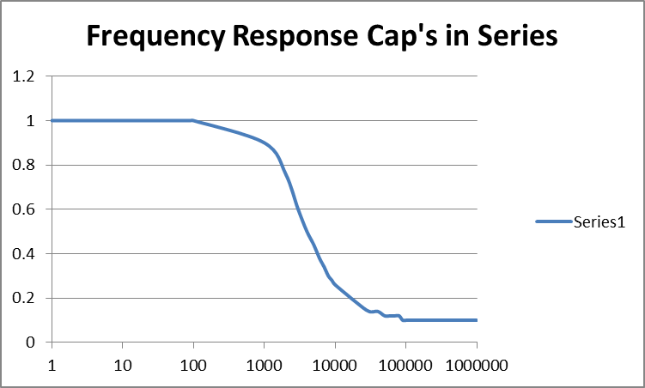
Xc as a Function of Frequency
Series Capacitors:
As frequency increases, Capacitance decreases.

Slide 10
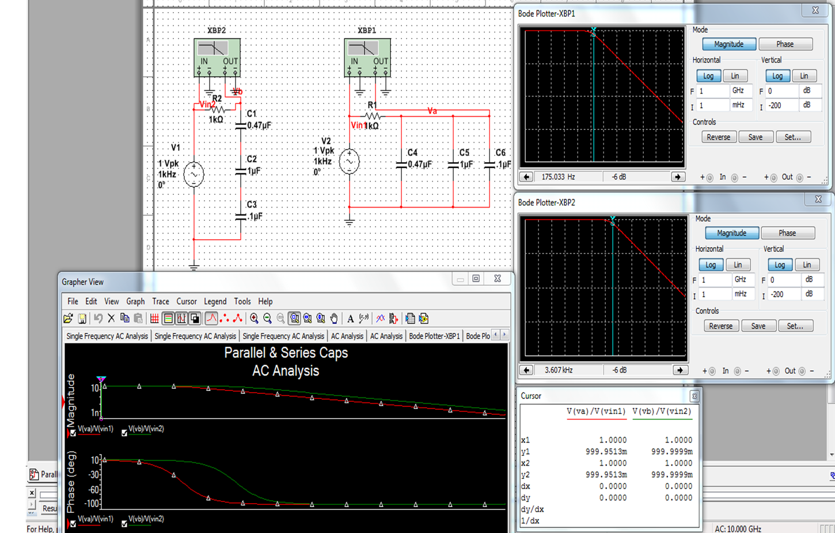
Xc as Function of Frequency

Slide 11
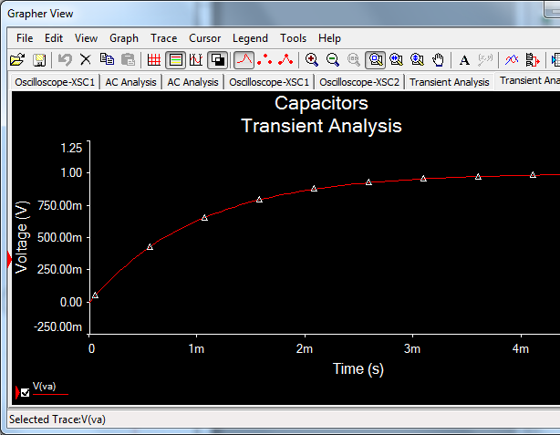
Xc Time Constant

Slide 12
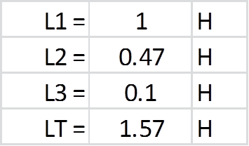
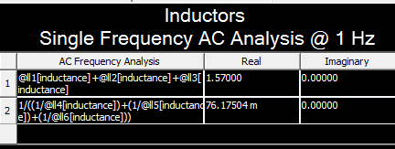
Inductors: Series & Parallel
(Small resistor added in simulation to keep circuit from “shorting” out.)
Series
Parallel
Verified in MultiSim

Slide 13
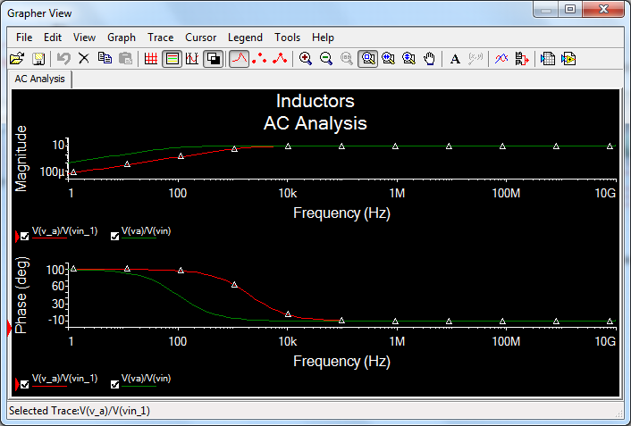
X_{L} as a Function of Frequency
Series
Parallel

Slide 14
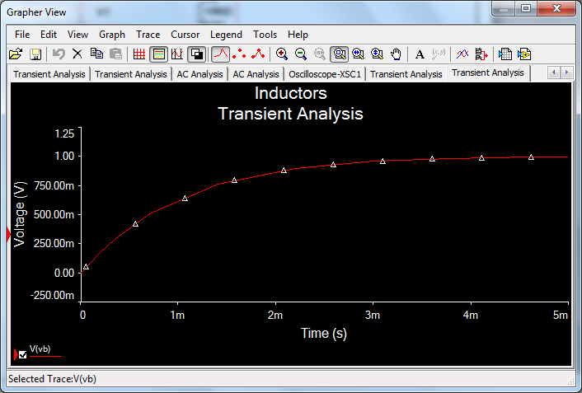
X_{L} Time Constants

